Slide 1
Chapter – 9 functional testing

Slide 2
Outline of the Chapter
Functional Testing Concepts of Howden
Different Types of Variables
Test Vectors
Howden’s Functional Testing Summary
Pairwise Testing
Orthogonal Array
In Parameter Order
Equivalence Class Partitioning
Guidelines for Equivalence Class Partitioning
Identification of Test Cases
Advantages of Equivalence Class Partitioning
Boundary Value Analysis (BVA)
Guidelines for Boundary Value Analysis
Decision Tables
Random Testing
Adaptive Random Testing
Error Guessing
Category Partition

Slide 3
Functional Testing Concepts
The four key concepts in functional testing are:
Precisely identify the domain of each input and each output variable
Select values from the data domain of each variable having important properties
Consider combinations of special values from different input domains to design test cases
Consider input values such that the program under test produces special values from the domains of the output variables

Slide 4
Different Types of Variables
Numeric Variables
A set of discrete values
A few contiguous segments of values
Arrays
An array holds values of the same type, such as integer and real. Individual elements of an array are accessed by using one or more indices.
Substructures
A structure means a data type that can hold multiple data elements. In the field of numerical analysis, matrix structure is commonly used.
Subroutine Arguments
Some programs accept input variables whose values are the names of functions. Such programs are found in numerical analysis and statistical applications

Slide 5
Test Vectors
A test vector is an instance of an input to a program, a.k.a. test data
If a program has n input variables, each of which can take on k special values, then there are k^{n} possible combinations of test vectors
We have more than one million test vectors even for k = 3 and n = 20
There is a need to identify a method for reducing the number of test vectors
It is suggested that there is no need of combining values of all input variables to design a test vector, if the variables are not functionally related
It is difficult to give a formal definition of the idea of functionally related variables, but it is easy to identify them
Variables appearing in the same assignment statement are functionally related
Variables appearing in the same branch predicate – the condition part of an if statement, for example – are functionally related

Slide 6
Test Vectors
Example of functionality-related variables
Functionality related variables

Slide 7
x1, . . . , x4 take on three special values and x5 is a Boolean variable. The total
number of combinations of the special values of the five input variables is
3^4 × 2 = 162.
Let us assume that program P has an internal structure as shown
in Figure b, where variables x1 and x2 are functionally related and variables x3 and x4 an functionally related.
The program P in Figure 9.3a has five input variables such that
and x4 are functionally related. Function f1 uses the input variables x1 and x2.
Similarly, function f2 uses the input variables x3 and x4. Input variable x5 is used
to decide whether the output of f1 or the output of f2 will be the output of P.
We consider 3^2 = 9 different combination of x1 and x2 as input to f1, 9 different
combinations of x3 and x4 as input to f2, and two different values of x5 to the
decision box d in P. We need 36 [(9 + 9) × 2] combinations of the five input
variables x1, . . . , x5, which is much smaller than 162.

Slide 8
Howden’s Functional Testing Summary
Let us summarize the main points in functional testing:
Identify the input and the output variables of the program and their data domains
Compute the expected outcomes as illustrated in Figure 9.5(a), for selected input values
Determine the input values that will cause the program to produce selected outputs as illustrated in Figure 9.5(b).

Slide 9
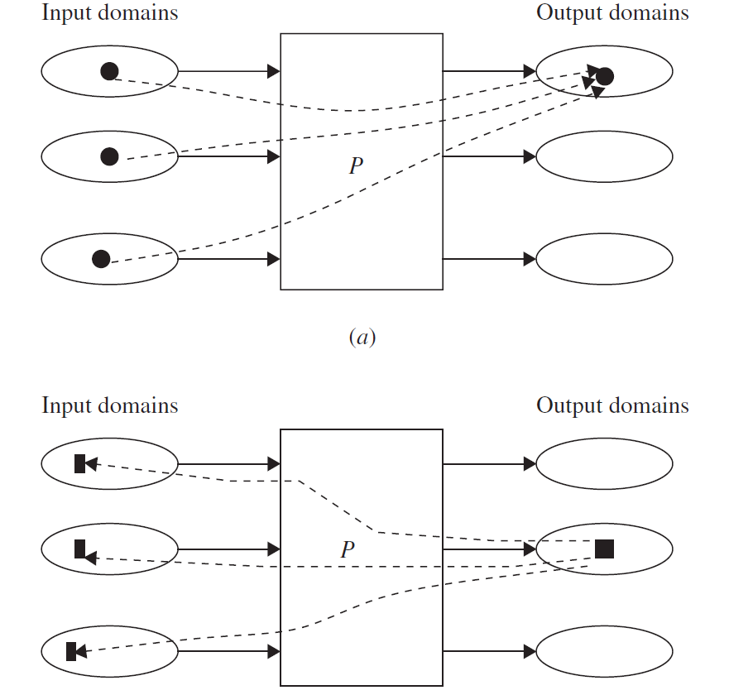

Slide 10
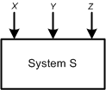
Pairwise Testing
Pairwise testing means that each possible combination of values for every pair of input variables is covered by at least one test case
Consider the system S in the figure, which has three input variables X, Y, and Z.
For the three given variables X, Y, and Z, their value sets are as follows: D(X) = {True, False}, D(Y) = {0, 5}, and D(Z) = {Q, R}
System S with three input variables.

Slide 11
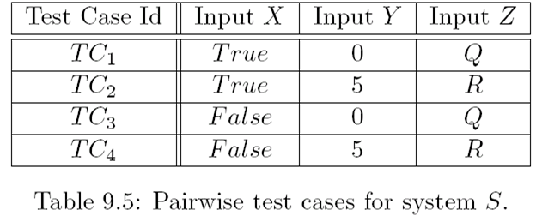
Pairwise Testing
The total number of all-combination test cases is 2 × 2 × 2 = 8
However, a subset of four test cases, as shown in Table 9.5, covers all pairwise combinations

Slide 12
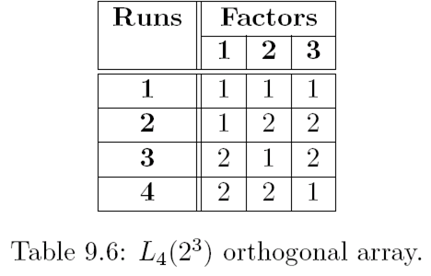
Orthogonal Array
Consider the two-dimensional array of integers shown in Table 9.6
This is an example of L₄(2³) orthogonal array
The “4” indicates that the array has 4 rows, also known as runs
The “2³” part indicates that the array has 3 columns, known as factors, and each cell in the array contains 2 different values, known as levels.
Levels mean the maximum number of values that a single factor can take on
Orthogonal arrays are generally denoted by the pattern L_{Runs}(Levels^{Factors})

Slide 13
Orthogonal Array
Let us consider our previous example of the system S.
The system S which has three input variables X, Y, and Z.
For the three given variables X, Y , and Z, their value sets are as follows: D(X) = {True, False}, D(Y ) = {0, 5}, and D(Z) = {Q,R}.
Map the variables to the factors and values to the levels onto the L₄(2³) orthogonal array (Table 9.6) with the resultant in Table 9.5.
In the first column, let 1 = True, 2 = False.
In the second column, let 1 = 0, 2 = 5.
In the third column, let 1 = Q, 2 = R.
Note that, not all combinations of all variables have been selected
Instead combinations of all pairs of input variables have been covered with four test cases

Slide 14
Orthogonal Array
Orthogonal arrays provide a technique for selecting a subset of test cases with the following properties:
It guarantees testing the pairwise combinations of all the selected variables
It generates fewer test cases than a all-combination approach.
It generates a test suite that has even distribution of all pairwise combinations
It can be automated

Slide 15
Orthogonal Array
In the following, the steps of a technique to generate orthogonal arrays are presented. The steps are further explained by means of a detailed example.
Step 1: Identify the maximum number of independent input variables with which a system will be tested. This will map to the factors of the array—each input variable maps to a different factor.
Step 2: Identify the maximum number of values that each independent variable will take. This will map to the levels of the array.
Step 3: Find a suitable orthogonal array with the smallest number of runs L_{Runs}(X^{Y}), where X is the number of levels and Y is the number of factors. A suitable array is one that has at least as many factors as needed from step 1 and has at least as many levels for each of those factors as identified in step 2.
Step 4: Map the variables to the factors and values of each variable to the levels on the array.
Step 5: Check for any “left-over” levels in the array that have not been mapped. Choose arbitrary valid values for those left-over levels.
Step 6: Transcribe the runs into test cases.

Slide 16
Orthogonal Array
Web Example. Consider a website that is viewed on a number of browsers with various plug-ins and operating systems (OSs) and through different connections as shown in Table 9.6. The table shows the variables and their values that are used as elements of the orthogonal array. We need to test the system with different combinations of the input values.

Slide 17
Orthogonal Array
Following the steps laid out previously, let us design an orthogonal array to create a set of test cases for pairwise testing:
Step 1: There are four independent variables, namely, Browser, Plug-in, OS, and Connection.
Step 2: Each variable can take at most three values.
Step 3: An orthogonal array L₉(3⁴) as shown in Table 9.7 is good enough for the purpose. The array has nine rows, three levels for the values, and four factors for the variables.
Step 4: Map the variables to the factors and values to the levels of the array: the factor 1 to Browser, the factor 2 to Plug-in, the factor 3 to OS, and the factor 4 to Connection. Let 1 = Netscape, 2 = IE, and 3 = Mozilla in the Browser column. In the Plug-in column, let 1 = Realplayer and 3 = Mediaplayer. Let 1 = Windows, 2 = Linux, and 3 = Macintosh in the OS column. Let 1 = LAN, 2 = PPP, and 3 = ISDN in the Connection column. The mapping of the variables and the values onto the orthogonal array is given in Table 9.8.

Slide 18
Orthogonal Array

Slide 19
Orthogonal Array
Step 5: There are left-over levels in the array that are not being mapped. The factor 2 has three levels specified in the original array, but there are only two possible values for this variable. This has caused a level (2) to be left over for variable Plug-in after mapping the factors. One must provide a value in the cell. The choice of this value can be arbitrary, but to have a coverage, start at the top of the Plug-in column and cycle through the possible values when filling in the left-over levels. Table 9.9 shows the mapping after filling in the remaining levels using the cycling technique mentioned.
Step 6: We generate nine test cases taking the test case values from each run. Now let us examine the result:
• Each Browser is tested with every Plug-in, with every OS, and with every Connection.
• Each Plug-in is tested with every Browser, with every OS, and with every Connection.
• Each OS is tested with every Browser, with every Plug-in, and with every Connection.
• Each Connection is tested with every Browser, with every Plug-in, and with every OS.

Slide 20
Orthogonal Array

Slide 21
Orthogonal Array

Slide 22
In Parameter Order
Tai and Lei have given an algorithm called In Parameter Order (IPO) to generate a test suite for pairwise coverage of input variables
The algorithm runs in three phases, namely, initialization, horizontal growth, and vertical growth, in that order
In the initialization phase, test cases are generated to cover two input variables
In the horizontal growth phase, the existing test cases are extended with the values of the other input variables.
In the vertical growth phase, additional test cases are created such that the test suite satisfies pairwise coverage for the values of the new variables.

Slide 23
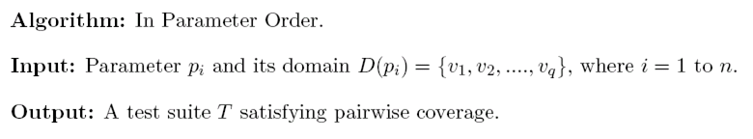
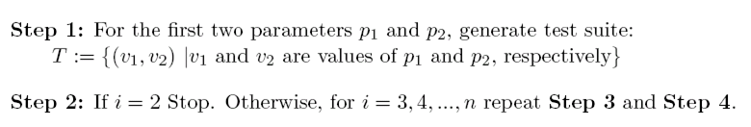
In Parameter Order
Initialization

Slide 24
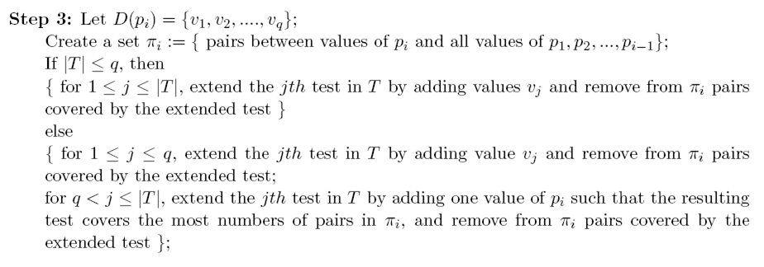
In Parameter Order
Horizontal Growth Phase

Slide 25
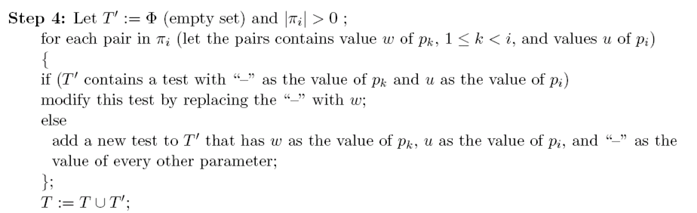
In Parameter Order
Vertical Growth Phase

Slide 26
In Parameter Order
Example:
Consider the system S which has three input parameters X, Y, and Z. Assume that a set D, a set of input test data values, has been selected for each input variable such that D(X) = {True, False}, D(Y) = {0, 5}, and D(Z) = {P,Q,R}. The total number of possible test cases is 2 × 2 × 3 = 12, but the IPO algorithm generates six test cases. Let us apply step 1 of the algorithm.

Slide 27
In Parameter Order
Initialization:
Step 1: Generate a test suite consisting of four test cases with pairwise coverage for the first two parameters X and Y:
Step 2: i = 3 > 2; therefore, steps 2 and 3 must be executed.

Slide 28
In Parameter Order
Horizontal Growth:
Step 1: Generate a test suite consisting of four test cases with pairwise coverage for the first two parameters X and Y:
Step 2: i = 3 > 2; therefore, steps 2 and 3 must be executed.

Slide 29
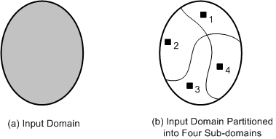
Equivalence Class Partitioning
An input domain may be too large for all its elements to be used as test input Figure (a)
The input domain is partitioned into a finite number of subdomains
Each subdomain is known as an equivalence class, and it serves as a source of at least one test input Figure (b).
A valid input to a system is an element of the input domain that is expected to return a non error value
An invalid input is an input that is expected to return an error value.
(a) Too many test input;
(b) One input is selected from each of the subdomain

Slide 30
Guidelines for Equivalence Class Partitioning
An input condition specifies a range [a, b]
one equivalence class for a < X < b, and
two other classes for X < a and X > b to test the system with invalid inputs
An input condition specifies a set of values
one equivalence class for each element of the set {M₁}, {M₂}, ...., {M_{N}}, and
one equivalence class for elements outside the set {M₁,M₂, ...,M_{N}}
Input condition specifies for each individual value
If the system handles each valid input differently then create one equivalence class for each valid input
An input condition specifies the number of valid values (Say N)
Create one equivalence class for the correct number of inputs
two equivalence classes for invalid inputs – one for zero values and one for more than N values
An input condition specifies a “must be” value
Create one equivalence class for a “must be” value, and
one equivalence class for something that is not a “must be” value

Slide 31
Identification of Test Cases
Test cases for each equivalence class can be identified by:
Assign a unique number to each equivalence class
For each equivalence class with valid input that has not been covered by test cases yet, write a new test case covering as many uncovered equivalence classes as possible
For each equivalence class with invalid input that has not been covered by test cases, write a new test case that covers one and only one of the uncovered equivalence classes

Slide 32
Advantages of Equivalence Class Partitioning
A small number of test cases are needed to adequately cover a large input domain
One gets a better idea about the input domain being covered with the selected test cases
The probability of uncovering defects with the selected test cases based on equivalence class partitioning is higher than that with a randomly chosen test suite of the same size
The equivalence class partitioning approach is not restricted to input conditions alone – the technique may also be used for output domains

Slide 33
Boundary Value Analysis (BVA)
The central idea in Boundary Value Analysis (BVA) is to select test data near the boundary of a data domain so that data both within and outside an equivalence class are selected
The BVA technique is an extension and refinement of the equivalence class partitioning technique
In the BVA technique, the boundary conditions for each of the equivalence class are analyzed in order generate test cases

Slide 34
Guidelines for Boundary Value Analysis
The equivalence class specifies a range
If an equivalence class specifies a range of values, then construct test cases by considering the boundary points of the range and points just beyond the boundaries of the range
The equivalence class specifies a number of values
If an equivalence class specifies a number of values, then construct test cases for the minimum and the maximum value of the number
In addition, select a value smaller than the minimum and a value larger than the maximum value.
The equivalence class specifies an ordered set
If the equivalence class specifies an ordered set, such as a linear list, table, or a sequential file, then focus attention on the first and last elements of the set.

Slide 35
Decision Tables
The structure of a decision table has been shown in Table 9.13
It comprises a set of conditions (or, causes) and a set of effects (or, results) arranged in the form of a column on the left of the table
In the second column, next to each condition, we have its possible values: Yes (Y), No (N), and Don’t Care (“-”)
To the right of the “Values” column, we have a set of rules. For each combination of the three conditions {C1,C2,C3}, there exists a rule from the set {R1,R2, ..,R8}
Each rule comprises a Yes (Y), No (N), or Don’t Care (“-”) response, and contains an associated list of effects {E1,E2,E3}
For each relevant effect, an effect sequence number specifies the order in which the effect should be carried out, if the associated set of conditions are satisfied
The “Checksum” is used for verification of the combinations, the decision table represent
Each rule of a decision table represents a test case

Slide 36
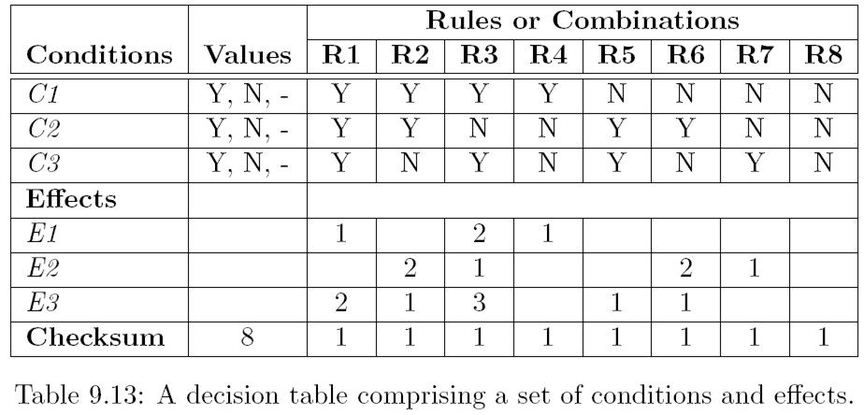
Decision Tables

Slide 37
Decision Tables
The steps in developing test cases using decision table technique:
Step 1: The test designer needs to identify the conditions and the effects for each specification unit.
A condition is a distinct input condition or an equivalence class of input conditions
An effect is an output condition. Determine the logical relationship between the conditions and the effects
Step 2: List all the conditions and effects in the form of a decision table. Write down the values the condition can take
Step 3: Calculate the number of possible combinations. It is equal to the number of different values raised to the power of the number of conditions

Slide 38
Decision Tables
Step 4: Fill the columns with all possible combinations – each column corresponds to one combination of values. For each row (condition) do the following:
Determine the Repeating Factor (RF): divide the remaining number of combinations by the number of possible values for that condition
Write RF times the first value, then RF times the next and so forth, until row is full
Step 5: Reduce combinations (rules). Find indifferent combinations - place a “-” and join column where columns are identical. While doing this, ensure that effects are the same
Step 6: Check covered combinations (rules). For each column calculate the combinations it represents. A “-” represents as many combinations as the condition has. Multiply for each “-” down the column. Add up total and compare with step 3. It should be the same
Step 7: Add effects to the column of the decision table. Read column by column and determine the effects. If more than one effect can occur in a single combinations, then assign a sequence number to the effects, thereby specifying the order in which the effects should be performed. Check the consistency of the decision table
Step 8: The columns in the decision table are transformed into test cases

Slide 39
Thank You!!

